Slide 1
Bilinguals’ perception of swear word offensiveness and emotional arousal
Zuzana Misankova

Slide 2
introduction
Bilinguals often report “feeling less” in their second language (L2) than their first (L1)
This is referred to as the Reduced emotional resonance of language
Swear words are perceived as having less of an emotional weight (Dewaele, 2004)
However, Dewaele (2016) found that bilinguals overestimate the offensiveness of swear words

Slide 3
hypotheses
The language of stimuli will be a significant predictor of the perceived offensiveness of swear words, with the ratings of offensiveness being lower when words are presented to participants in their L1
The language of stimuli will be a significant predictor of the perceived emotional arousal of swear words, with the ratings of emotional arousal being higher when words are presented to participants in their L1
I.
II.

Slide 4
Methods
Materials
The emotional arousal of swear words questionnaire
The Reduced Emotional resonance in LX (RER-LX)
Lexical Test for Advanced Learners of English (LEXtale)
Participants
314 Slovak-English bilingual participants
Design
Dependent variables:
The perceived offensiveness of swear words questionnaire
Predictor variables:
the ratings of perceived offensiveness of swear words.
The ratings of emotional arousal of swear words.
the language of presented swear words
the reduced emotional resonance of the language

Slide 5
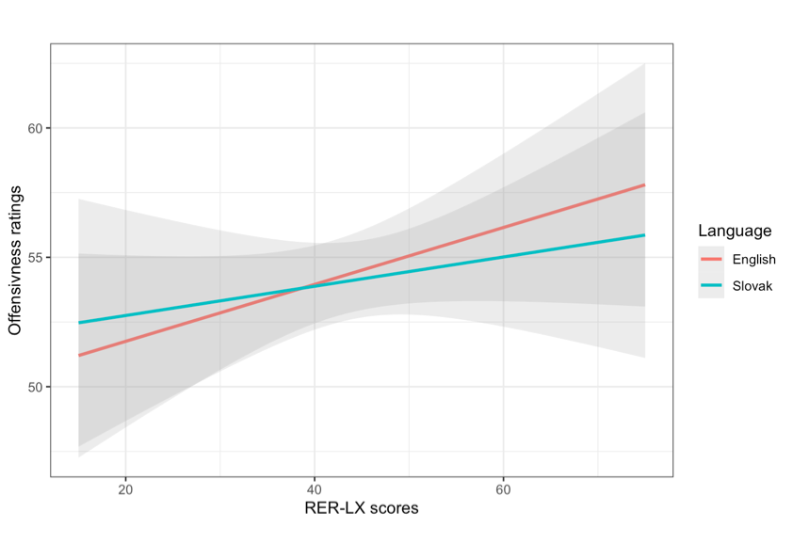
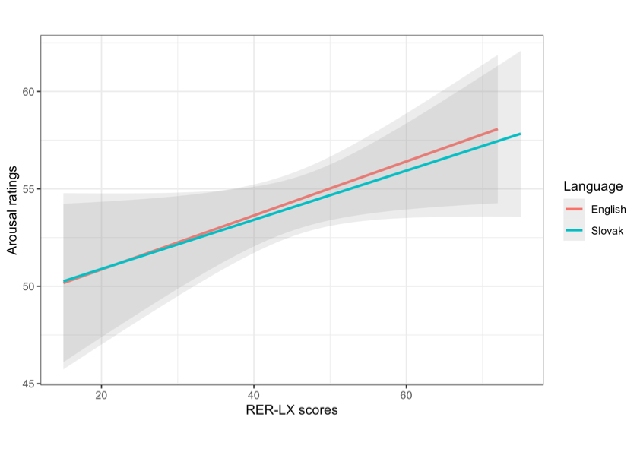
Results
Offensiveness findings:
A significant positive effect of language on offensiveness
No significant effect of the RER-LX scores on offensiveness ratings was found
Emotional Arousal findings:
A positive effect of the reduced emotional resonance of language
No significant effect of language on arousal ratings was detected
words were rated as more offensive when presented in L1
higher RER-LX scores predicted higher arousal ratings across both language conditions.

Slide 6
Discussion
Both hypotheses had to be rejected
Findings were not consistent with those of previous studies
Dewaele (2016) study used a between-subjects design, whilst the current study used a within-subjects design
Past studies on emotional arousal used physiological measures, whilst I used self-report
In conclusion
Language has an effect on the perceived offensiveness of swear words as rated by bilinguals
No significant effect of language on the perceived emotional arousal of swear words was found

Slide 7
Thank you for your attention!

Slide 8
references
Dewaele, J. (2004). The emotional force of swearwords and taboo words in the speech of multilinguals. Journal of Multilingual and Multicultural Development
Dewaele, J. (2016). Thirty shades of offensiveness: L1 and LX english users’ understanding, perception and self-reported use of negative emotion-laden words.Journal of Pragmatics, 94, 112-127. https://doi.org/10.1016/j.pragma.2016.01.009

